Slide 1
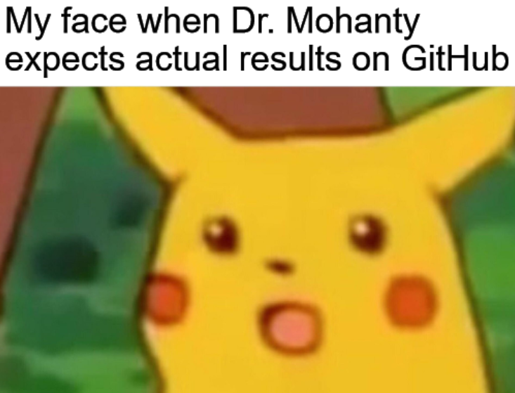
Edesia
Sprint Retrospective #9
Team Blue
Adam Bowers | Daniel Wingo | Stephen Bennett | Jonathan Holley
Github: aLotofAdam | 81wingo | stephenbennett2 | mccauley747
UNCG: ajbower3 | dtwingo | scbenne3 | jbholley

Slide 2
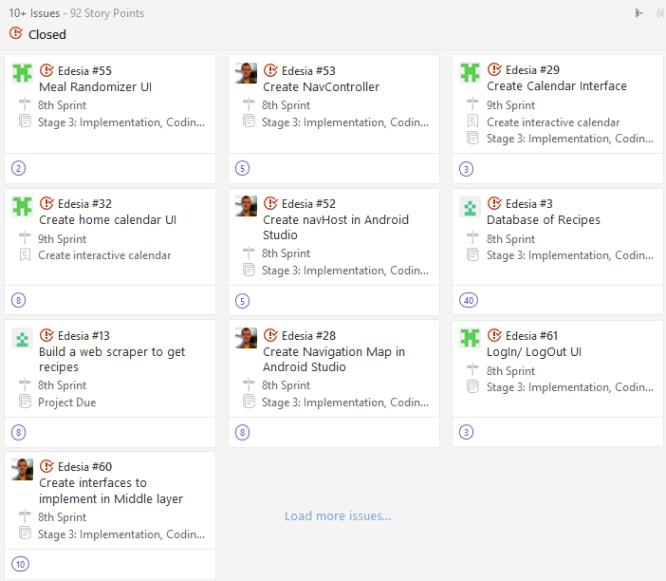
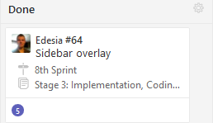
Last Sprint
NavHost, Controller
Presentation Layer
Database
Login/out UI
Sign Up UI
Main Subsystems UI

Slide 3
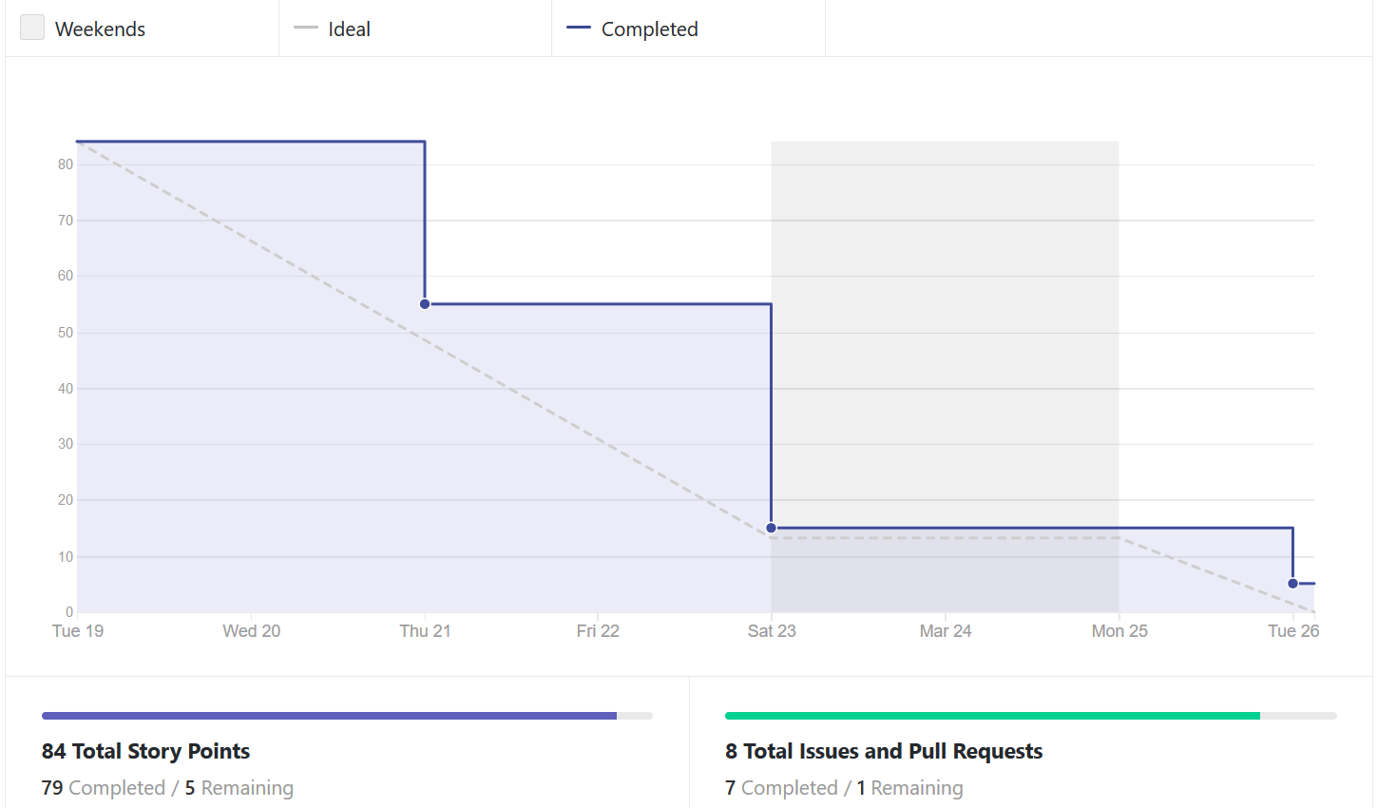
Burndown Chart

Slide 4
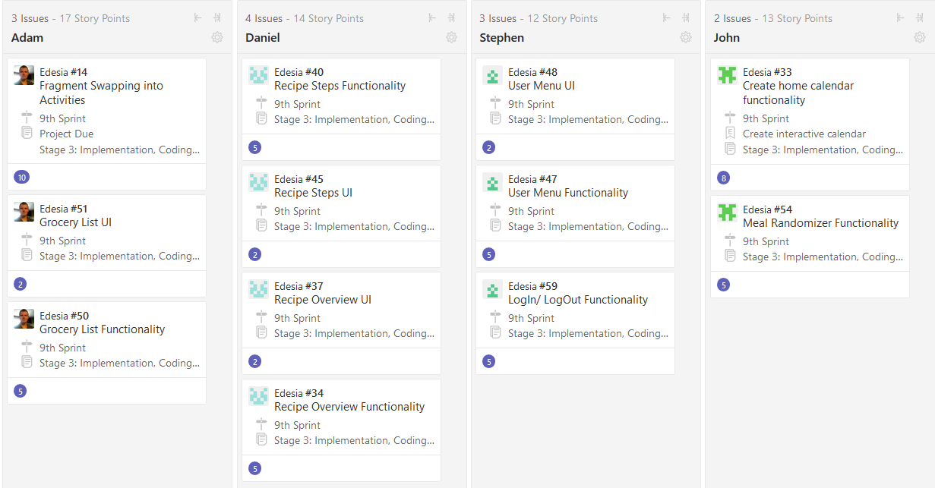
Current Sprint

Slide 5
Android Studio and XMLs
Fighting Fragments
Swapping into main activity
Grocery List
Drawers and Bars

Slide 6
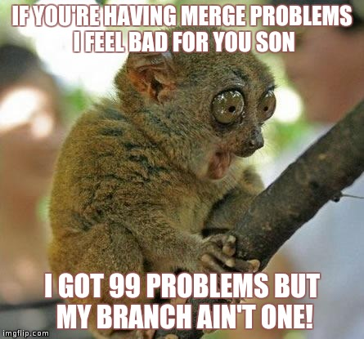
Recipe Pages for the app
Working on GUI for Recipe Search fragment
Database helper for Recipe Database to the application
Next will be the middle lay for recipe search page

Slide 7
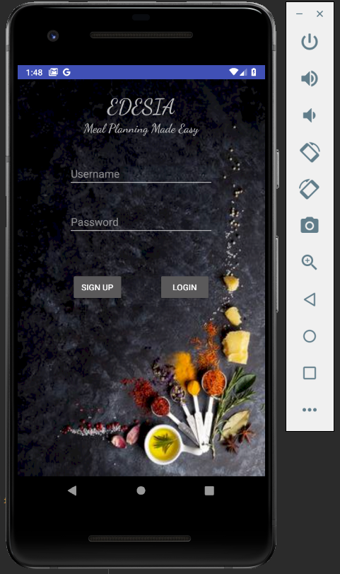
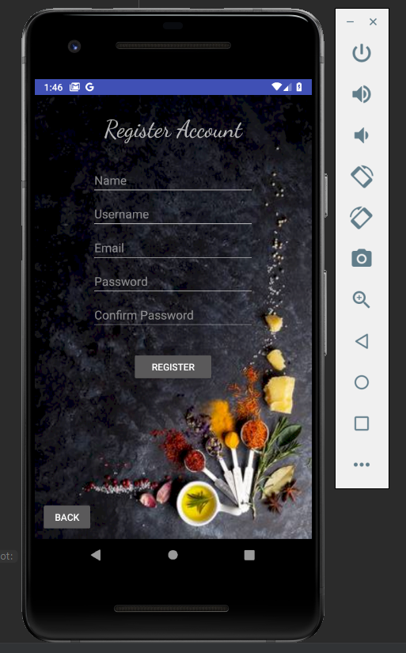
User Login/Signup
-Everything is mapped to user database for login and register.
-Currently working on getting fragments to work properly (switch from activities-only). Having issues with null values and display kicking off.
-Next move is correcting a few more merge issues, and moving on to the next page not worked on.

Slide 8
Calendar Subsystems
Finished Calendar UI
Finished Expanded Day View UI
Finished Meal Randomizer UI
Partial Functionality is finished on Calendar UI
Working on Drag and Drop interface for Expanded Day View

Slide 9
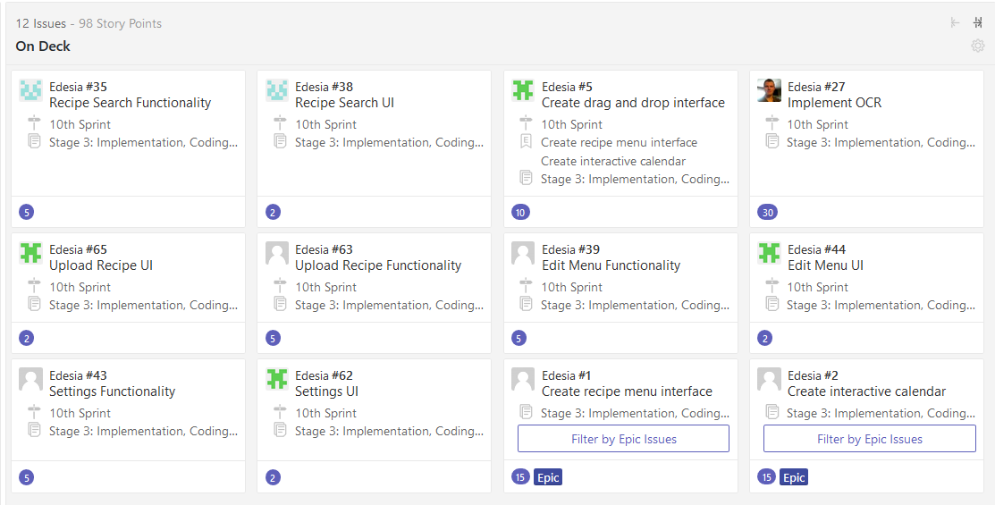
Next Sprint

